Slide 1


Department of Electronics and Communication Engineering
DIABETES PREDICTON
Group No:07
Sl.No | NAME | USN
1. | Harsh Patil | 02FE21BEC035
2. | Manjunath Balekundri | 02FE21BEC048
3. | Ankita Bhosale | 02FE21BEC008
4. | Rakshita Shivapooji | 02FE21BEC068
Under the Guidance of
Dr. Dattaprasad Torse

Slide 2
Need statement:
Prediction of diabetes using logistic regression

Slide 3
Introduction:
Diabetes mellitus is a chronic metabolic disorder characterized by elevated blood glucose levels.Results from insufficient insulin production or ineffective use of insulin.
In the context of predicting diabetes, logistic regression becomes a valuable tool for modeling the relationship between various patient characteristics (features) and the likelihood of having diabetes.
We are Collecting a dataset with features (independent variables) such as age, BMI, blood pressure, etc., and a binary target variable indicating diabetes presence (1) or absence (0).
From data collection and preprocessing to model training, evaluation, and interpretation, each stage contributes to a comprehensive understanding of how logistic regression aids in making informed predictions about diabetes onset.

Slide 4
Flowchart:
Select Data set
Load Data
Data Visualisation
Data
Pre-processing
Diabetic?
Yes
Testing
Training
No

Slide 5
Block Diagram:
Data set
Data Cleaning
Logistic Regression Algorithm
Training
Testing
Display Result

Slide 6
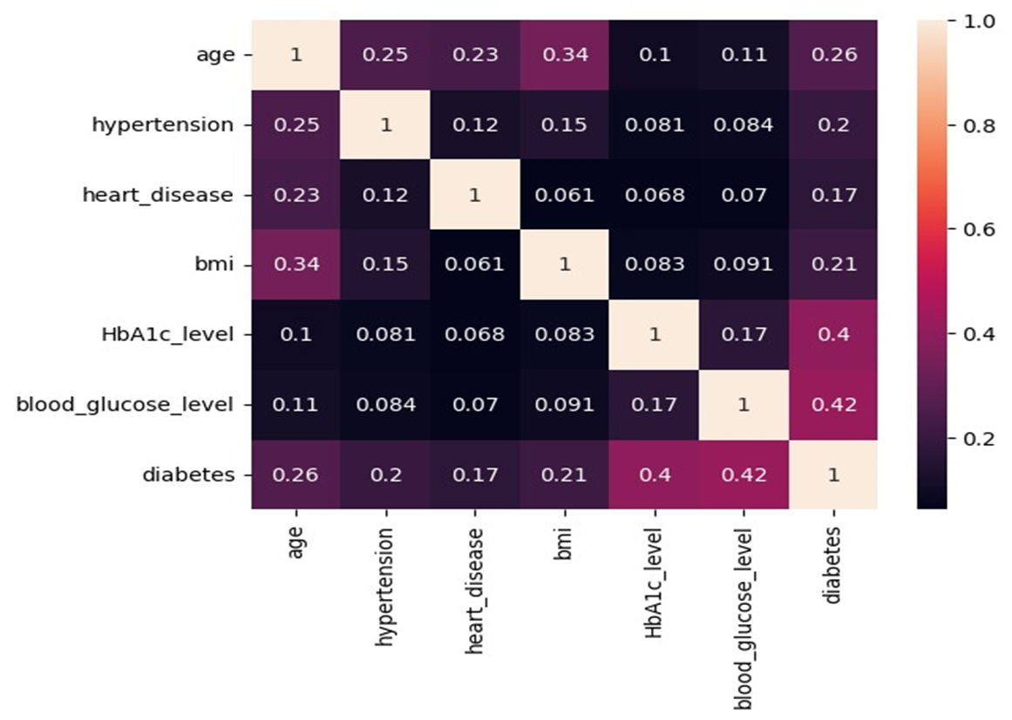
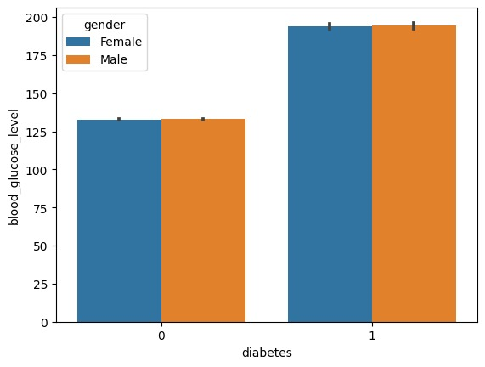
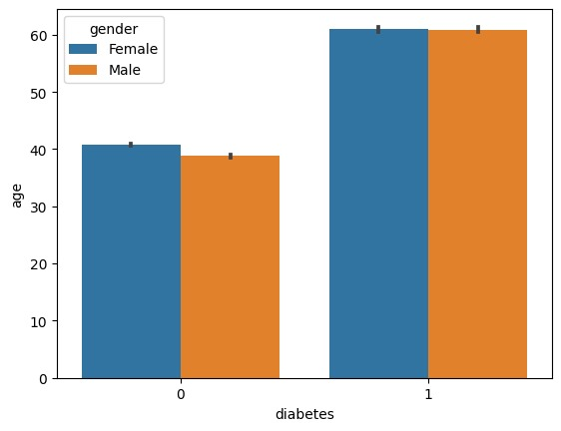
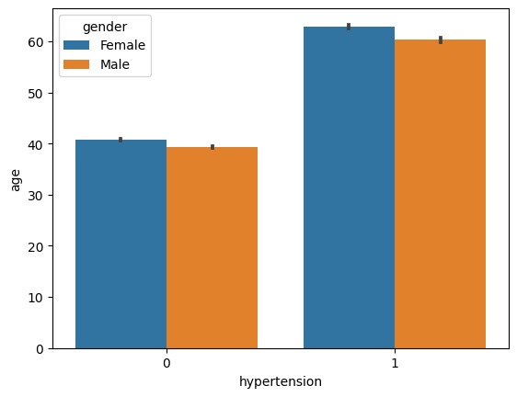

Slide 7
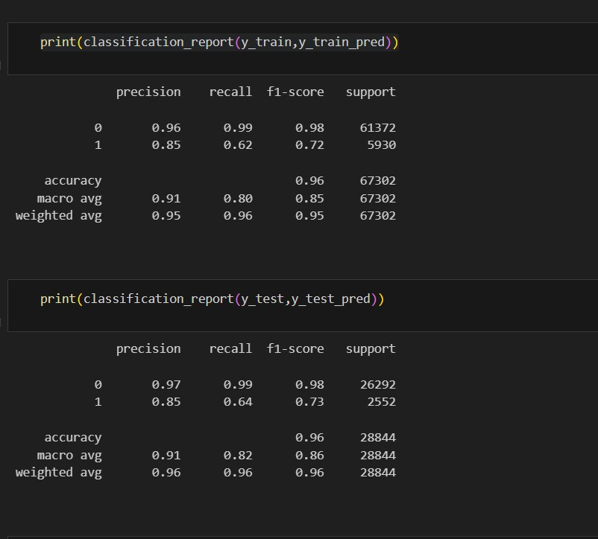
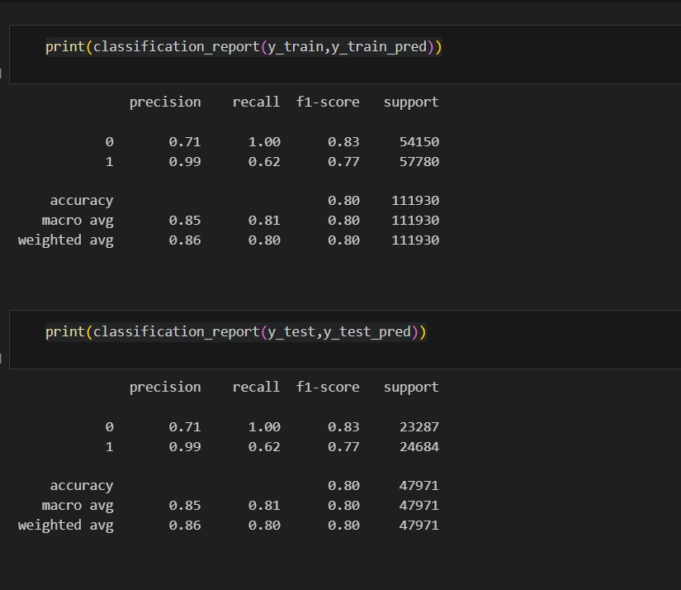
Output:
Before balancing After balancing

Slide 8
Future Scope:
Improved Models and Algorithms
Integration with Electronic Health Records (EHRs)
Integration of Additional Features
Machine Learning Optimization
Continuous Monitoring and Wearable Technology:

Slide 9
GIT-HUB LINK:
https://github.com/Manjunathbalekundri/MACHINE_LEARNING_PROJECT.git

Slide 10
References
T. N. Joshi and P. M. Chawan, “Logistic regression and svm based diabetes prediction system,” International Journal For Technological Research In Engineering, vol. 5, pp. 4347–4350, 2018
M. Soni and S. Varma, “Diabetes prediction using machine learning techniques,” International Journal of Engineering Research & Technology (Ijert) Volume, vol. 9, 2020.
A. Sharma, K. Guleria, and N. Goyal, “Prediction of diabetes disease using machine learning model,” in International Conference on Communication, Computing and Electronics Systems: Proceedings of ICCCES 2020, pp. 683–692, Springer, 2021.
M. Panda, D. P. Mishra, S. M. Patro, and S. R. Salkuti, “Prediction of diabetes disease using machine learning algorithms,” IAES International Journal of Artificial Intelligence, vol. 11, no. 1, p. 284, 2022.

Slide 11
THANK YOU

